Slide 1

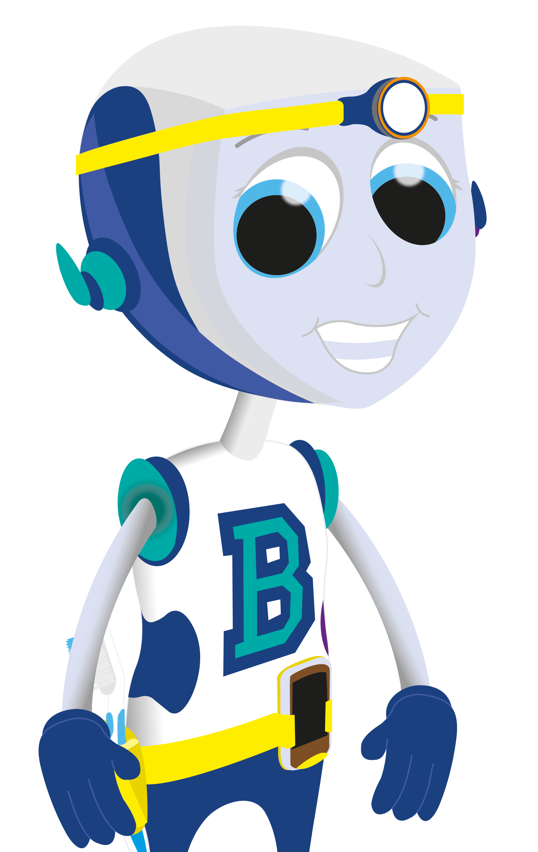

Types of Teeth

Slide 2
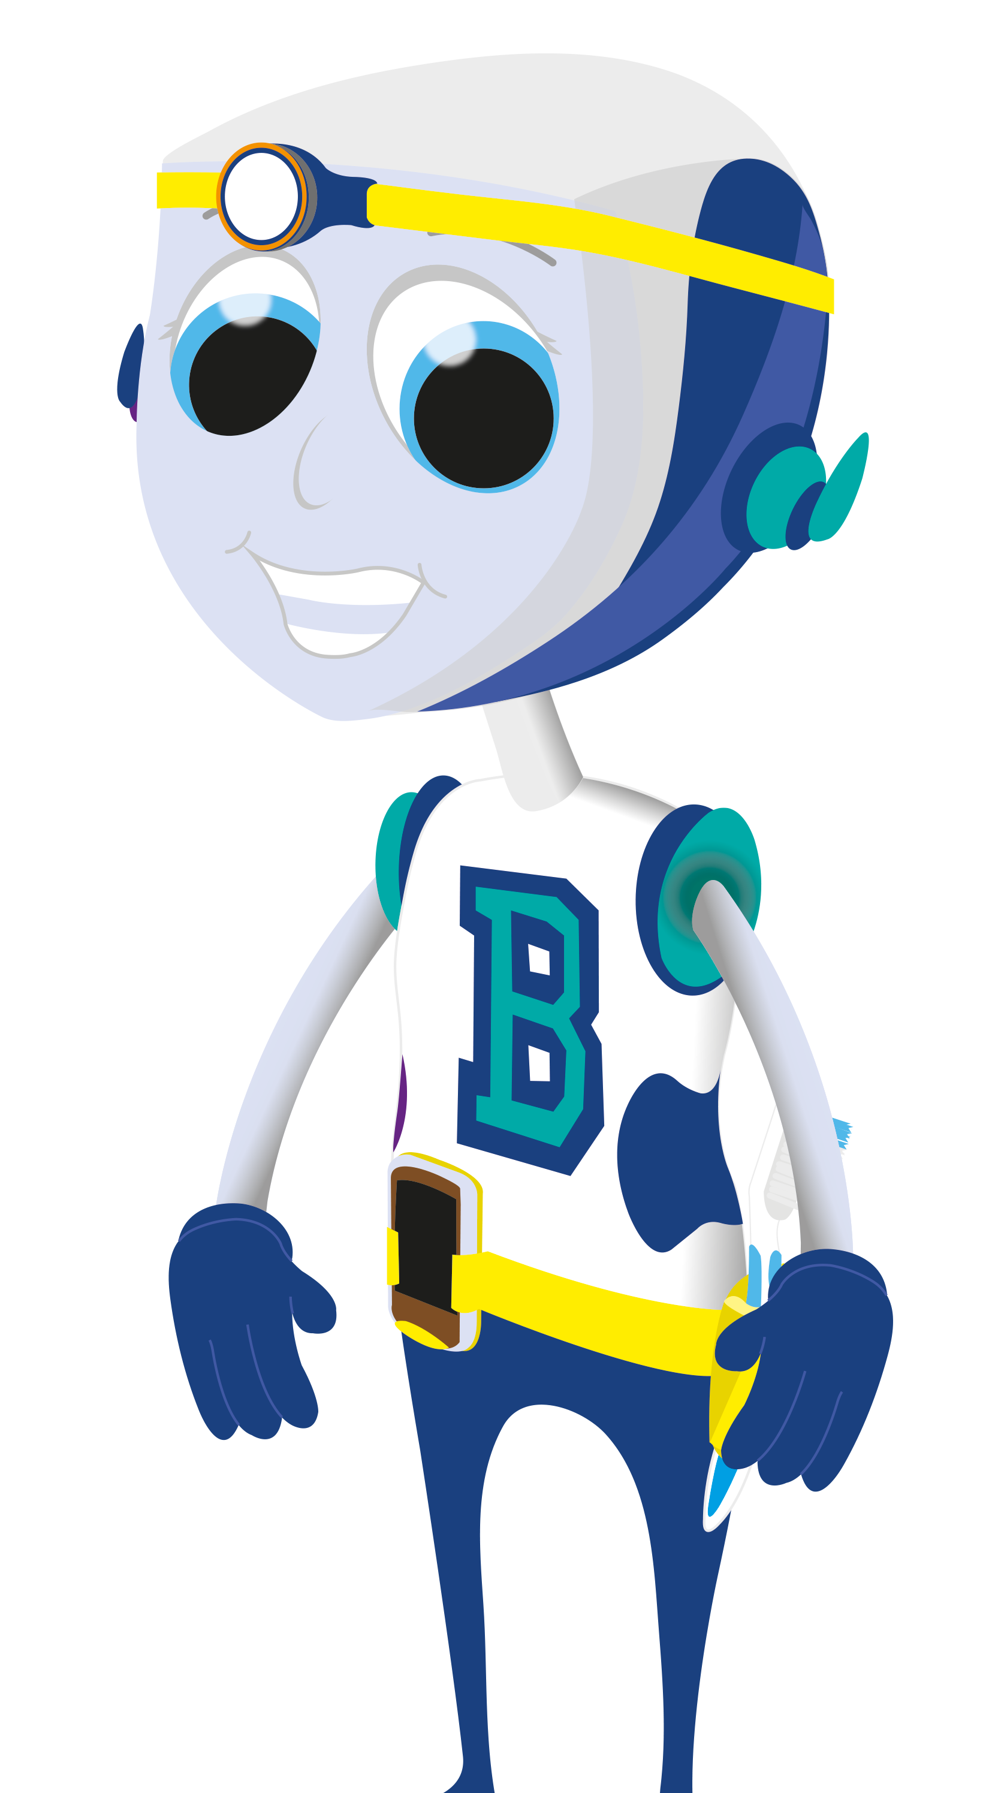

Why do we have teeth?
Th ey help us to eat They help us to speak They shape our face They allow us to be confident in our smile
© Oral Health Foundation www.dentalhealth.org
Can you think of anything else?

Slide 3

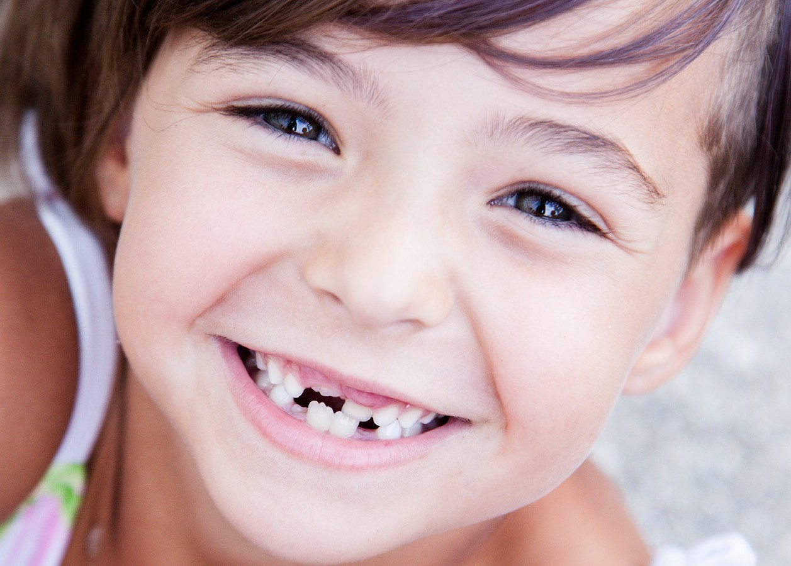
We have 20 ‘baby’ teeth, when these ‘wobble’ out they are replaced by our ‘adult ’ teeth.
We have 32 adult teeth (including 4 wisdom teeth)
© Oral Health Foundation www.dentalhealth.org

Slide 4
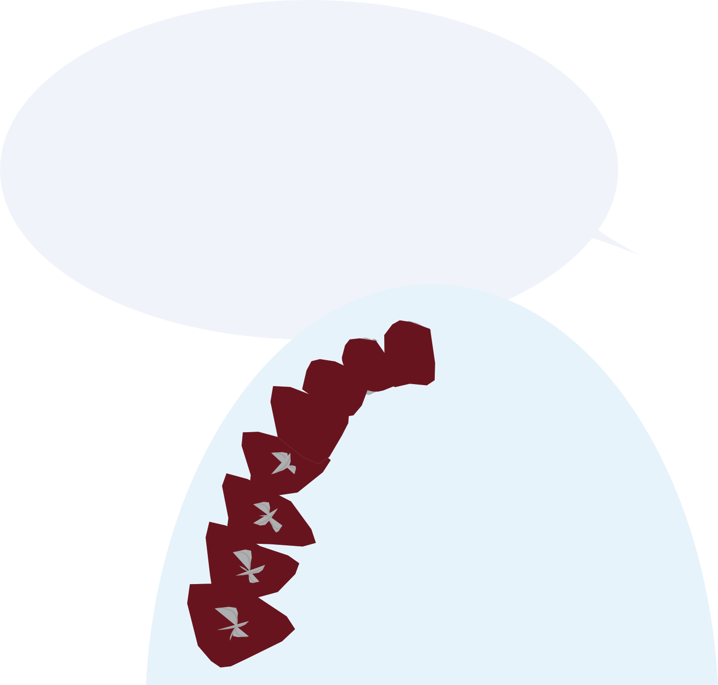


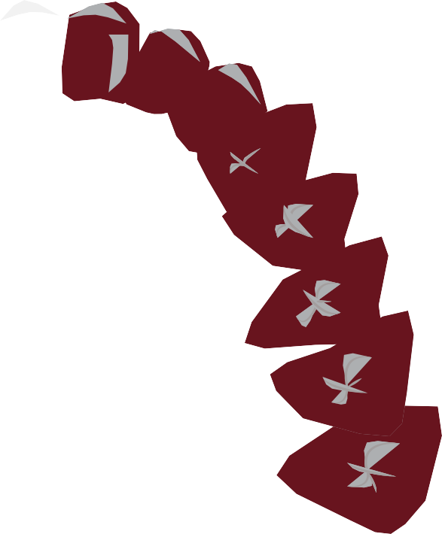







We have 4 different
types of teeth;
each do a different job:
© Oral Health Foundation www.dentalhealth.org

Slide 5

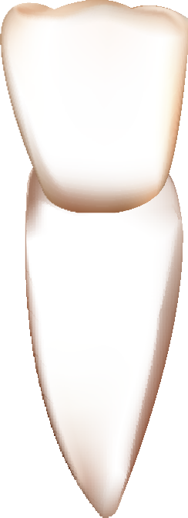
Incisors
these are front teeth and they bite into food and cut it into smaller pieces
© Oral Health Foundation www.dentalhealth.org

Slide 6
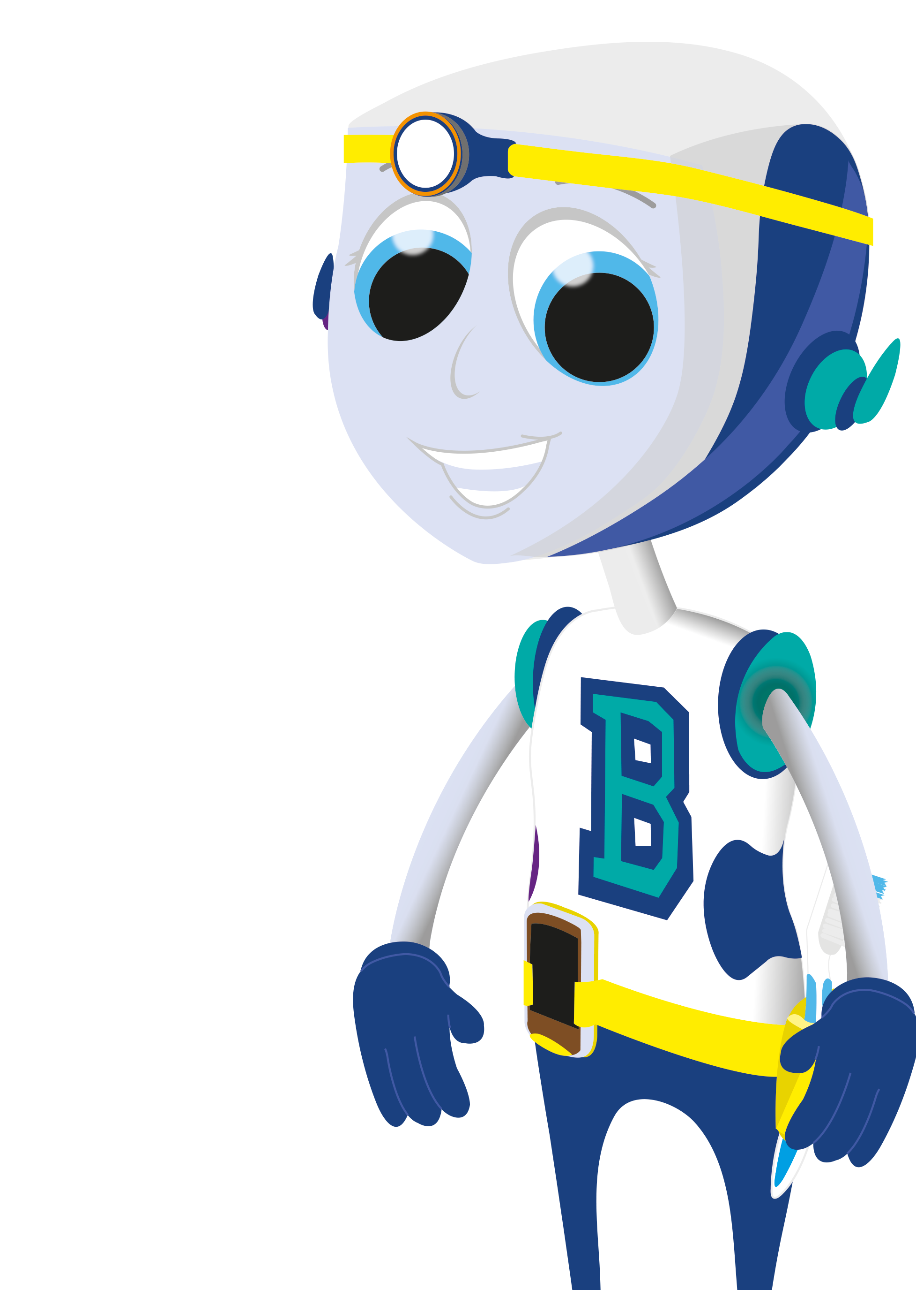
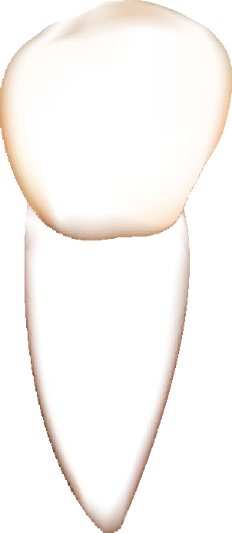
Canines these are sharp, pointed teeth and
are used to tear food.
© Oral Health Foundation www.dentalhealth.org

Slide 7

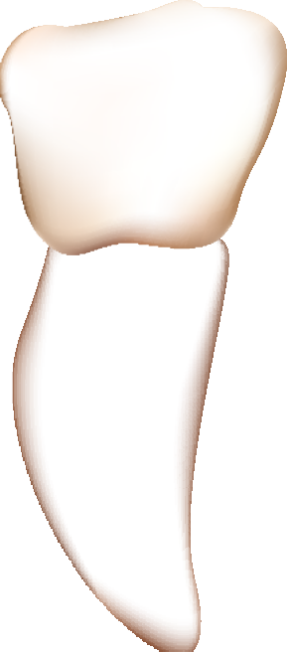
Premolars these are bigger than incisors and canine teeth, they
grind up the food.
© Oral Health Foundation www.dentalhealth.org

Slide 8
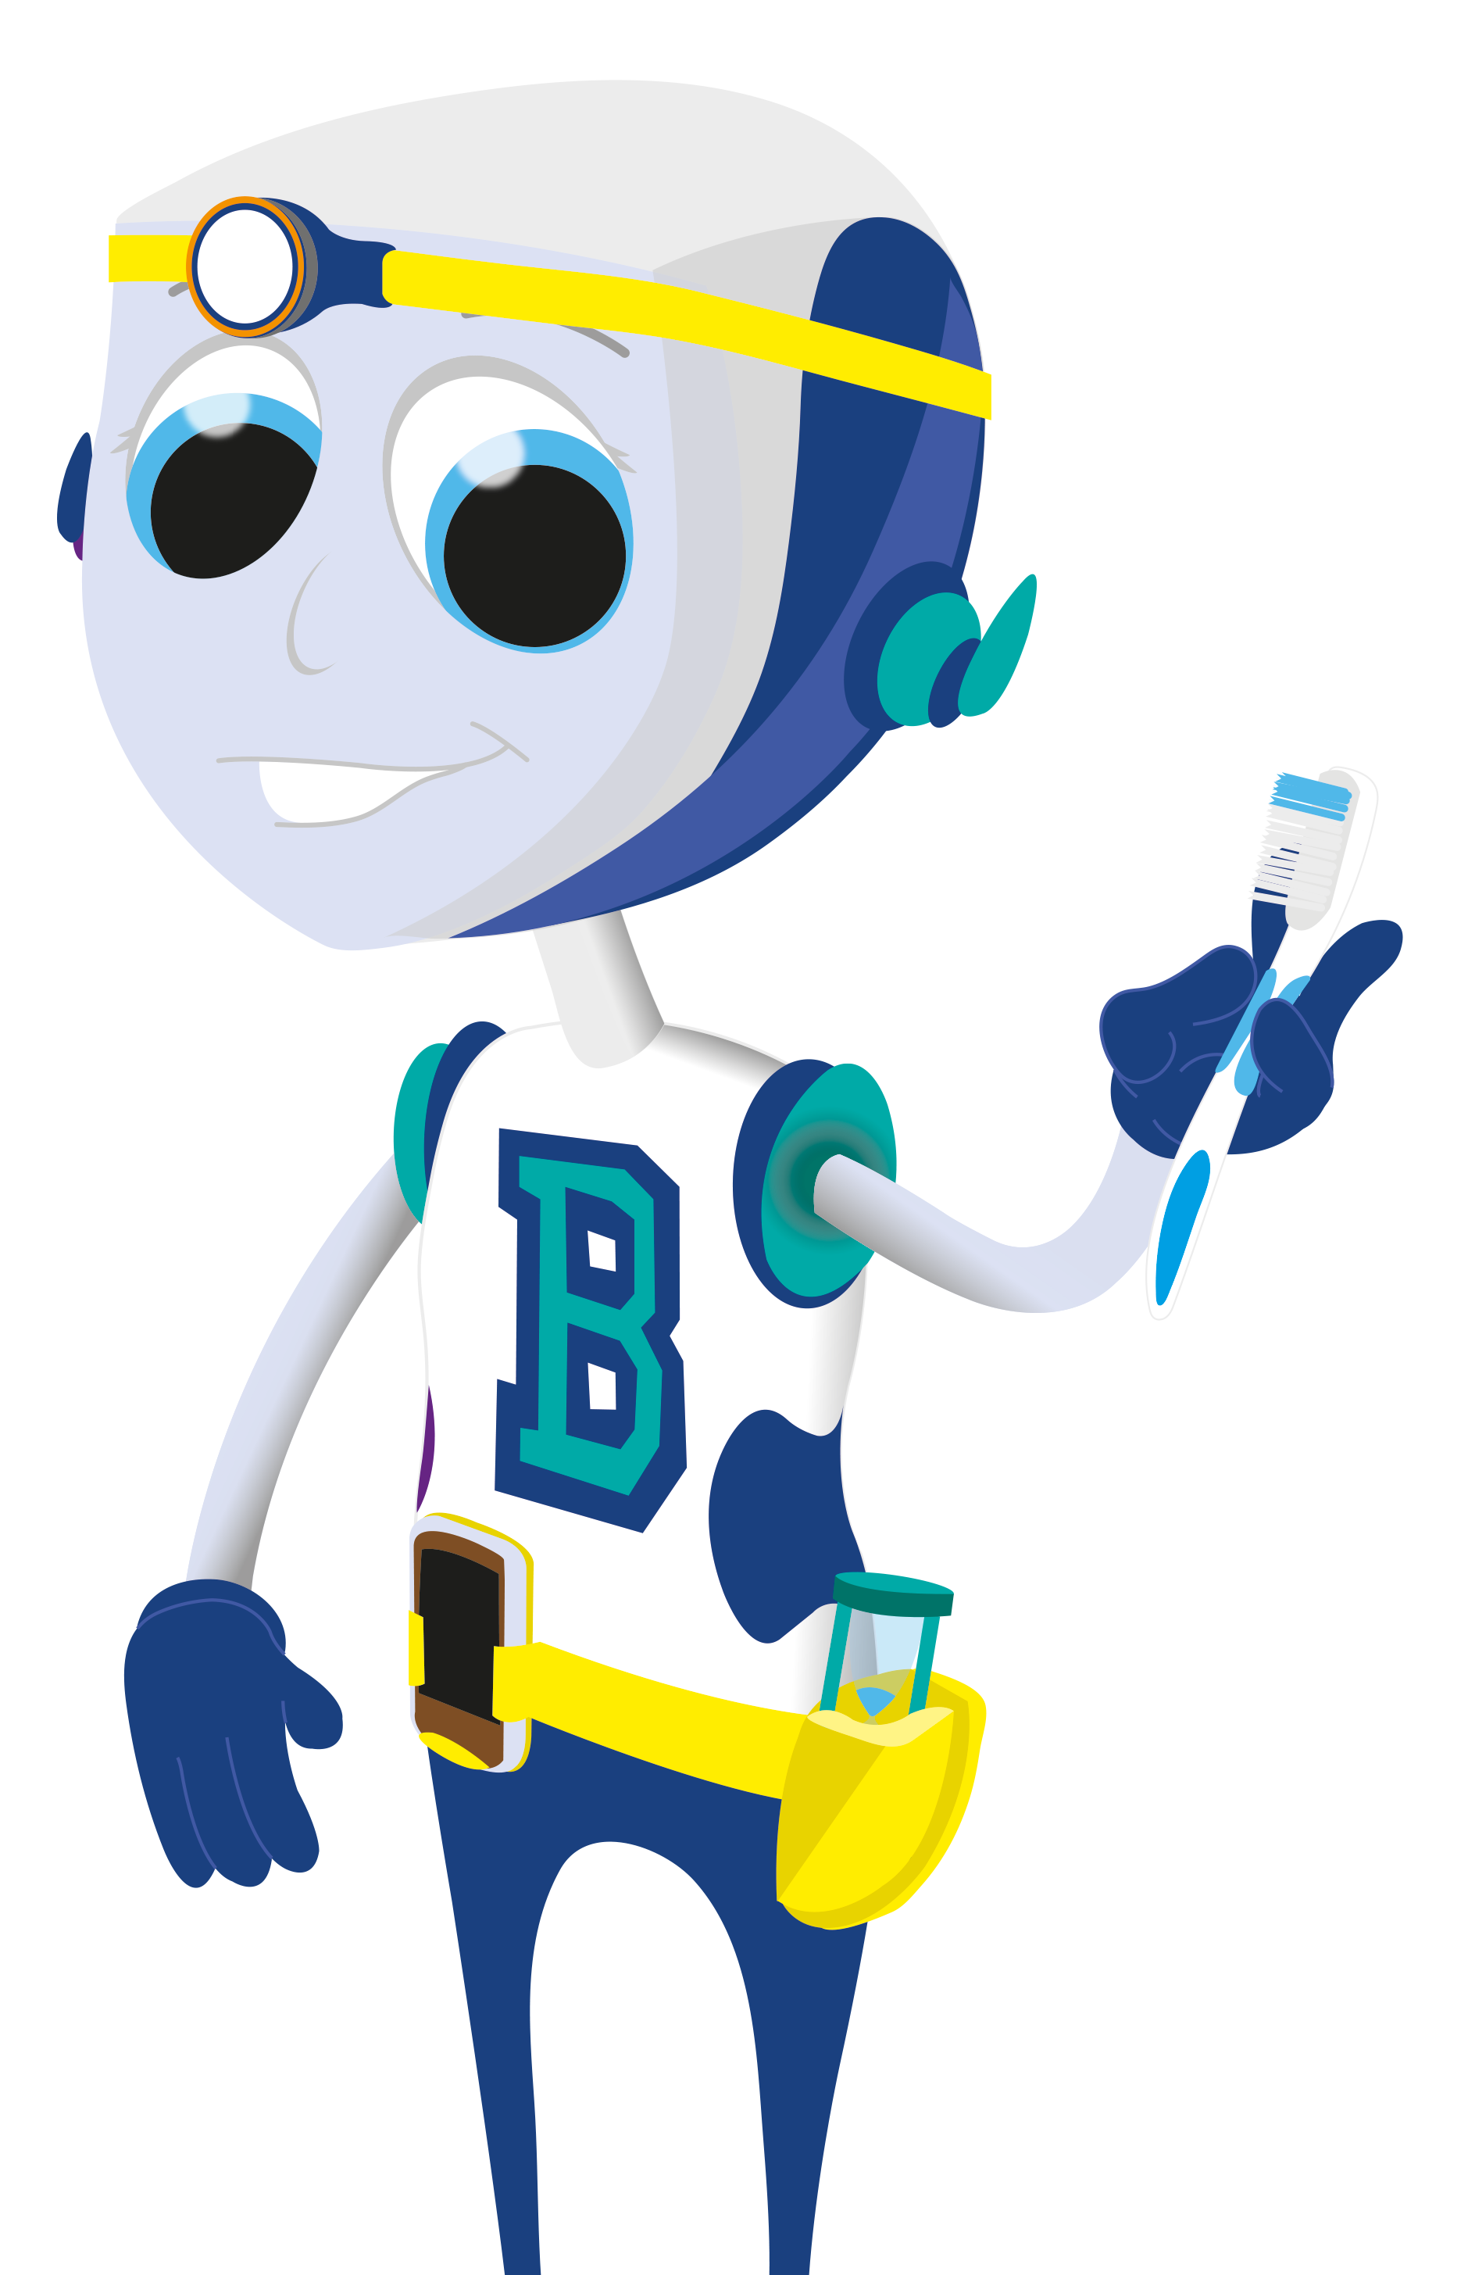

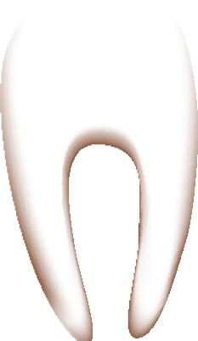
Molars
these are the biggest teeth, they have a large, flat surface to grind the food.
© Oral Health Foundation www.dentalhealth.org

Slide 9
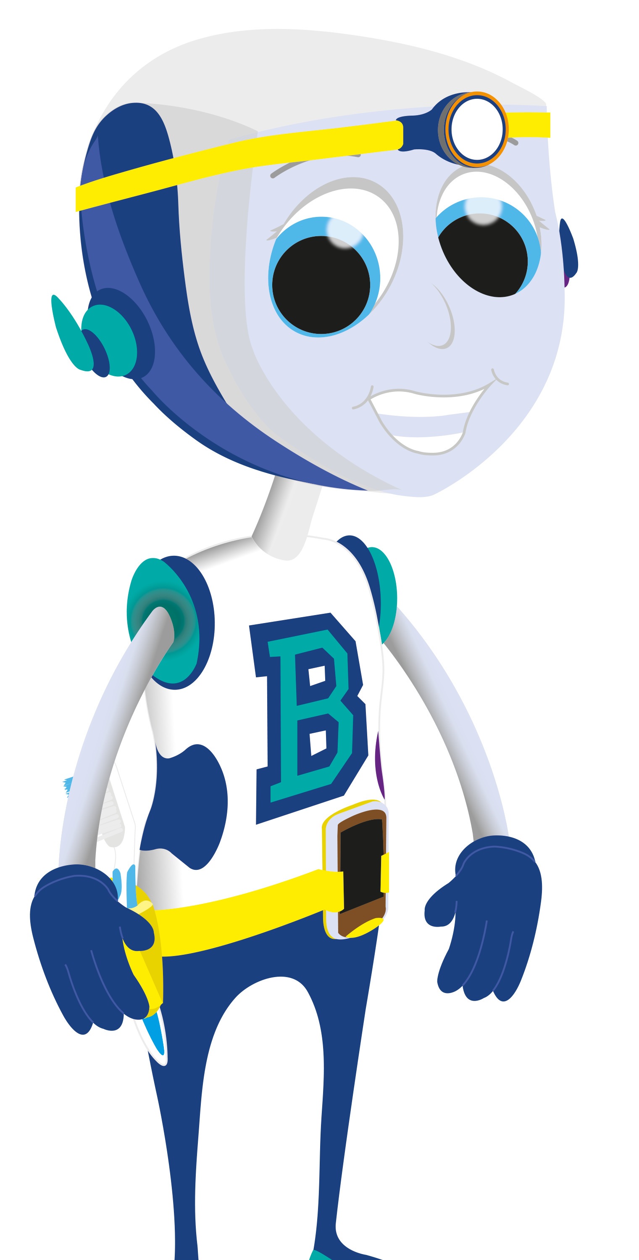
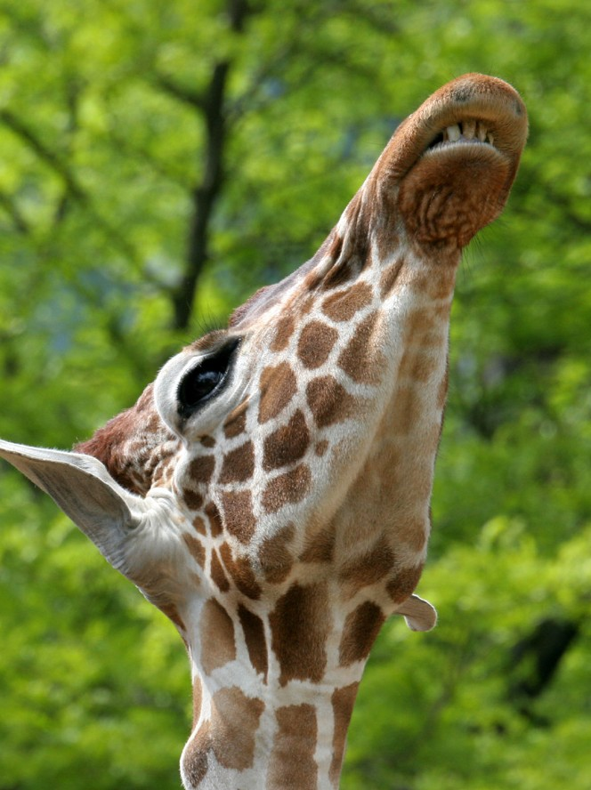
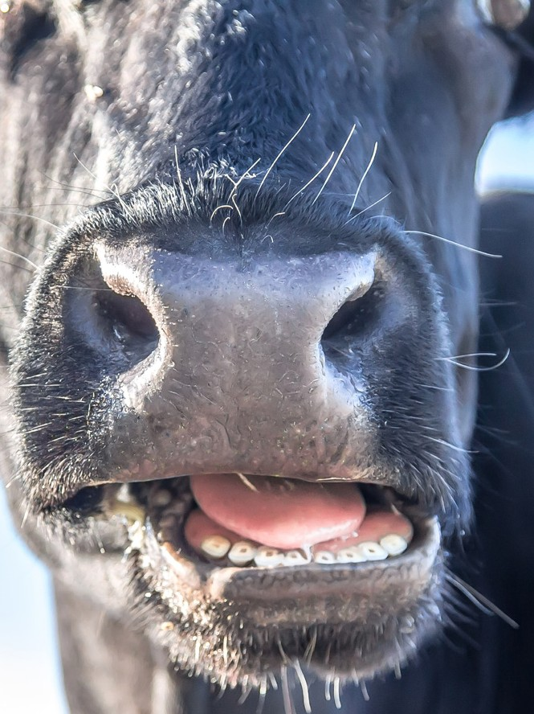
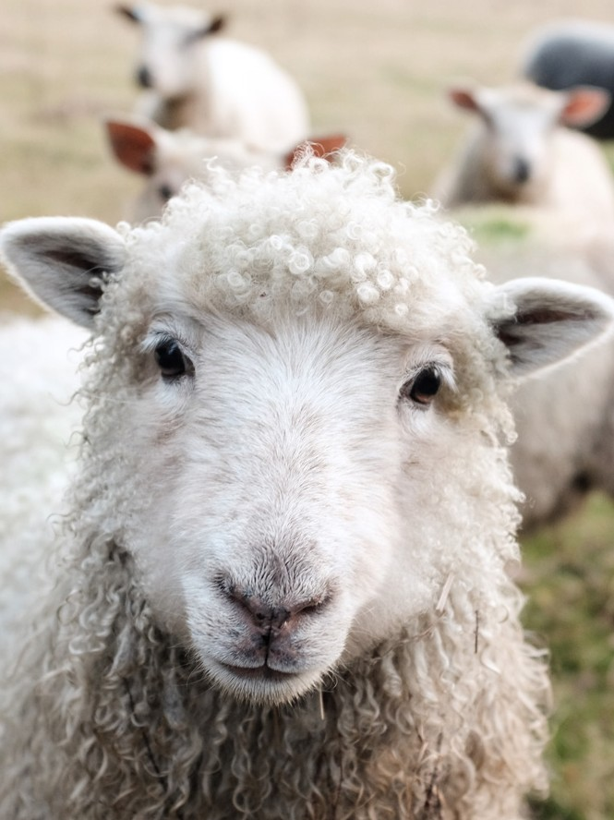
Animals that only eat plants are called herbivores and have large, flat teeth to grind the vegetation before they can swallow it.
© Oral Health Foundation www.dentalhealth.org

Slide 10

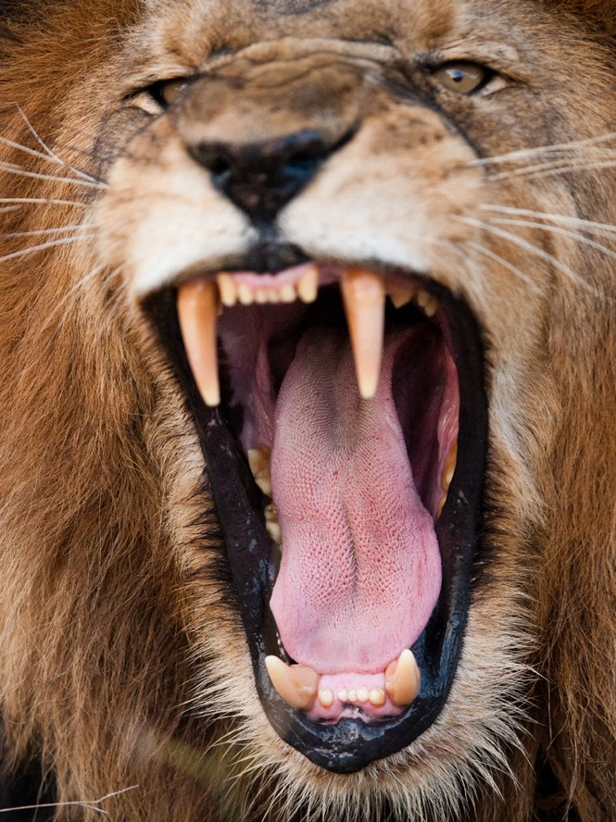
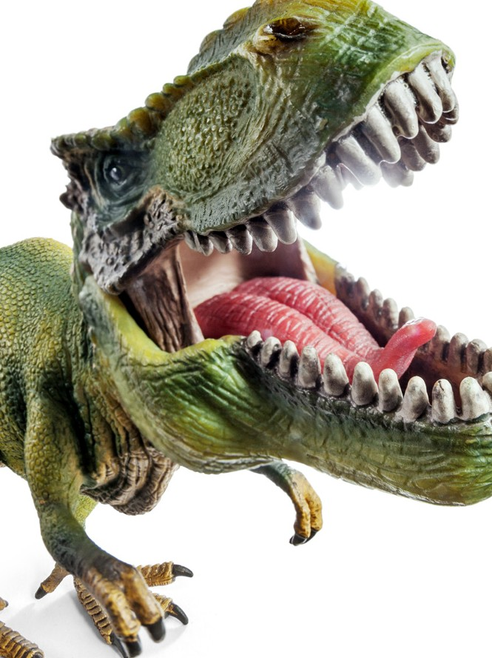
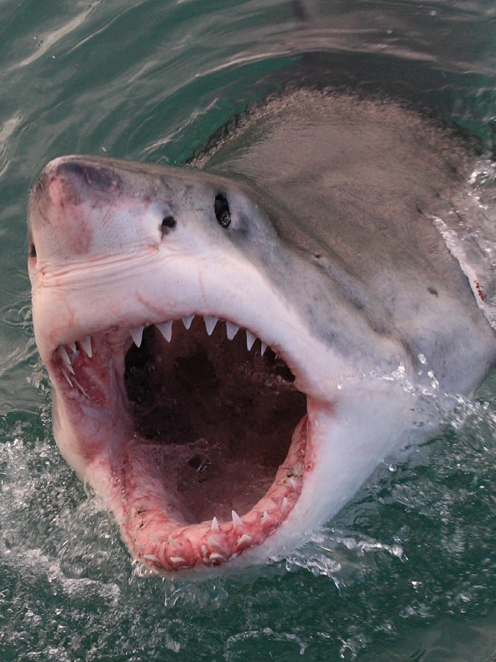
There are also creatures that only eat meat and they are called carnivores. They have large sharp, pointed teeth to rip and tear the meat.
© Oral Health Foundation www.dentalhealth.org

Slide 11







Animals, like humans, that eat both vegetables and meat are called omnivores. They have a mixture of teeth that can cut and tear but can also grind food too.
© Oral Health Foundation www.dentalhealth.org
Incisors
(bite)
Canines
(tear)
Premolars
(grind)
Molars
(grind)

Slide 12

We need to have a balanced and varied diet to help keep us healthy and to protect our teeth.
© Oral Health Foundation www.dentalhealth.org

Slide 13

We use our teeth to cut, tear and chew food to break it down so we can swallow it:
Fruit and vegetables
Cheese
Nuts and seeds
Breadsticks
Rice cakes
Protein - meat, fish, beans and pulses
Carbohydrates - potatoes, pasta, rice
© Oral Health Foundation www.dentalhealth.org
Discuss which teeth do we use to eat these?

Slide 14
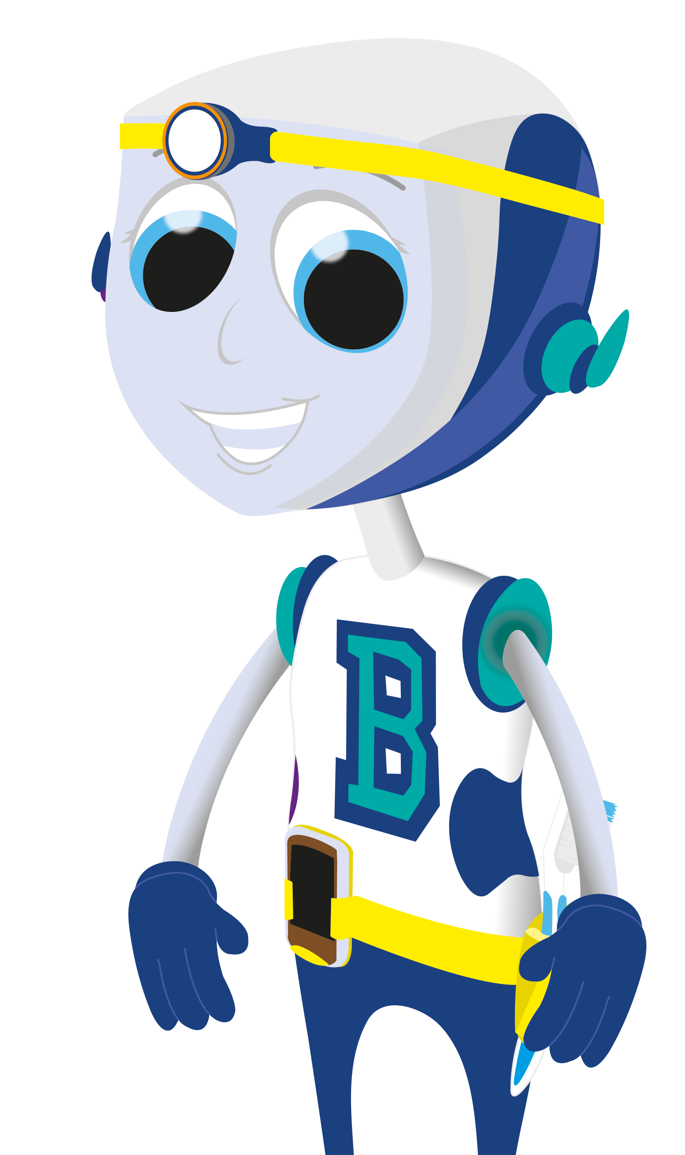
Sugary food that we should try to avoid.
Sweets
Biscuits
Cakes
Dried fruit
Cereal bars
Chocolate
Puddings
Pastries
Ice cream
Discuss which teeth do we use to eat these?
© Oral Health Foundation www.dentalhealth.org

