Slide 1
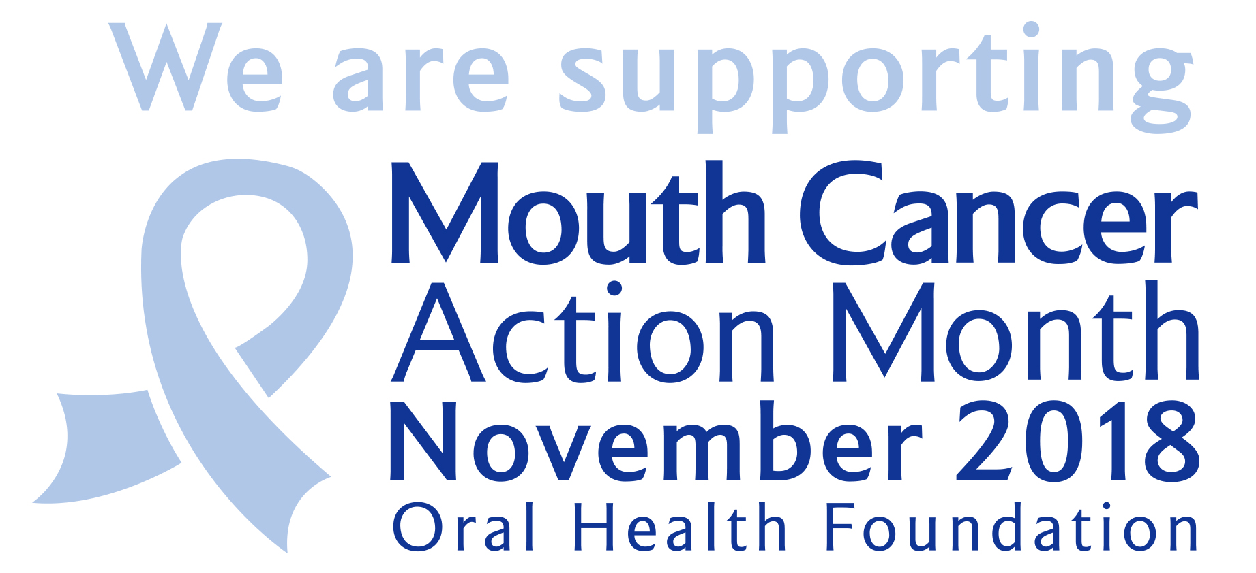
Mouth Cancer Action Month
‘If in doubt, get checked out’

Slide 2
About mouth cancer
Mouth cancer can affect the lips, tongue, cheeks, head and neck.
There are more than 7,500 new cases diagnosed in the UK each year.
Mouth cancer is more common in those over 40, particularly men.
But it’s now affecting more younger people and women than ever.
The number of new cases of mouth cancer is on the increase.

Slide 3
What causes mouth cancer?
Smoking – tobacco in cigarettes / pipes and smokeless tobacco.
Drinking alcohol to excess – increases risks by four times.
Human Papillomavirus – transmitted via oral sex.
Unhealthy diet – not eating enough fruit, vegetables and fish.
Sunlight – over-exposure can lead to cancer in the lips.

Slide 4
What should you be looking for?
Mouth cancer can strike the lips, tongue, gums, cheeks, head and neck.
Early detection is crucial so know the early warning signs:
Mouth ulcers which do not heal within three weeks;
Red and white patches in the mouth;
Unusual lumps or swellings in the mouth, head or neck.
If any of these are noticed, tell your dentist or doctor immediately.

Slide 5
Early detection is crucial
Mouth cancer can be spotted in the early stages by your dentist.
Your dentist or hygienist will do this as part of your dental check-up.
If mouth cancer is recognised early, the chances of a cure are good.
Many people with mouth cancer go to their dentist or doctor too late.
It is important to visit your dentist regularly, as often as they recommend.

Slide 6
Stay healthy by being mouthaware
Be Mouthaware by being alert to unusual changes in your mouth.
Report any red or white patches, unusual lumps and swellings, or mouth ulcers that have not cleared up within three weeks.
When exposed to the sun, be sure to use protective sun cream.
A good diet, rich in Vitamins A, C and E.
Cut down on your smoking and drinking.

Slide 7
If in doubt, get checked out
Fact
Check
Act
More than 7,500 people will be diagnosed with mouth cancer this year in the UK.
Look out for mouth ulcers which do not heal within three weeks, red & white patches, and unusual lumps or swellings.
Regularly visit your dentist to ensure you are checked for signs of mouth cancer.

Slide 8
If in doubt, get checked out.
Speak to your dentist or doctor.
For more information about mouth cancer visit www.mouthcancer.org
An Oral Health Foundation charity campaign
Smile House, Rugby, Warwickshire, CV22 6AJ
©Oral Health Foundation | Registered Charity No. 263198

